Slide 1
Electronic Devices
Mid Term Lecture - 05
Reference book:
Electronic Devices and Circuit Theory
Robert L. Boylestad and L. Nashelsky , (11th Edition)

Slide 2
CLIPPERS
Clippers are networks that employ diodes to “clip” away a portion of an input signal without distorting the remaining part of the applied waveform.
There are two general categories of clippers: series and parallel.
The series configuration is defined as one where the diode is in series with the load, whereas the parallel variety has the diode in a branch parallel to the load.

Slide 3
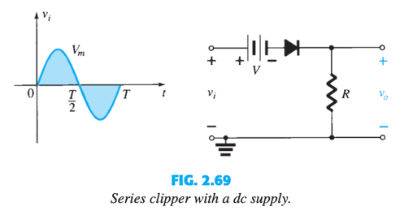
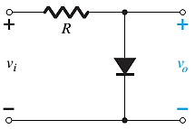
CLIPPERS: SERIES & PARALLEL
Diode is in series with the load.
Diode in a branch parallel to the load.

Slide 4
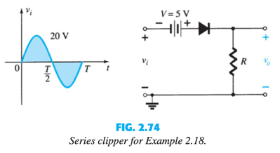

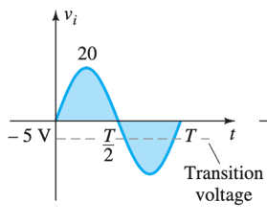
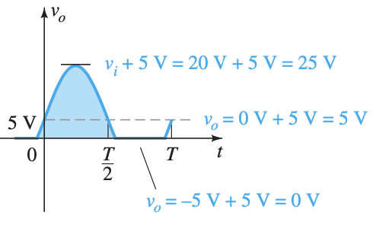
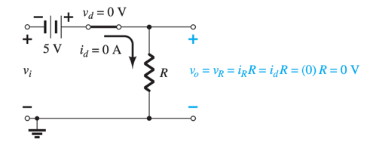
CLIPPERS: SERIES

Slide 5
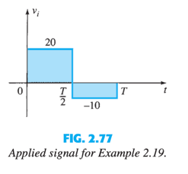
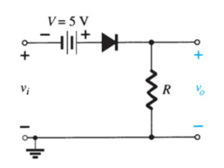
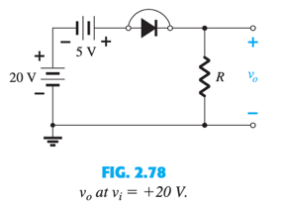
CLIPPERS: SERIES
For positive half cycle,
The diode is in the short-circuit state.
v_{o} = 20V + 5V = 25V

Slide 6
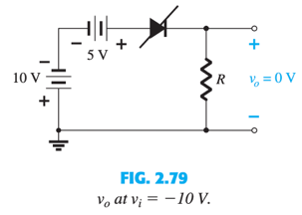
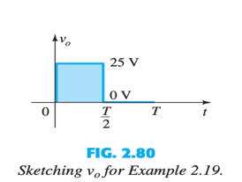
For negative half cycle,
The diode is in the “off” state.
v_{o} = i_{R}R = (0)R = 0 V
The resulting output voltage corresponds to input voltage appears as:

Slide 7
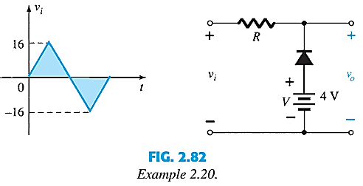
CLIPPERS: PARALLEL
Determine output across the series combination of the diode and the 4-V supply

Slide 8
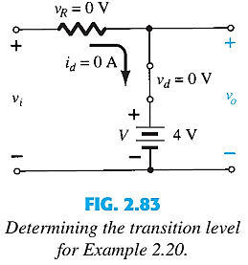
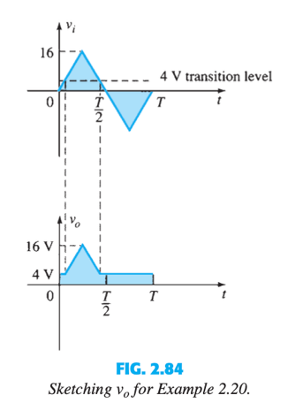
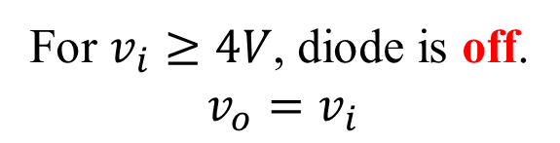
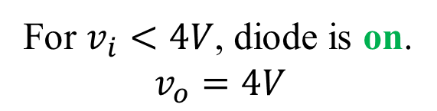
For $v_{i}<4V$, diode is on.
$$v_{o}=4V$$
For $v_{i}≥4V$, diode is off.
$$v_{o}=v_{i}$$

Slide 9
CLIPPERS: PARALLEL
Si

Slide 10
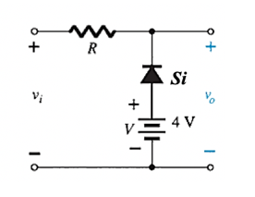
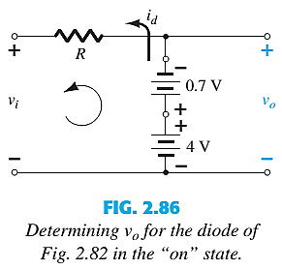
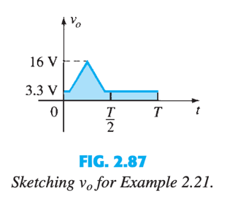
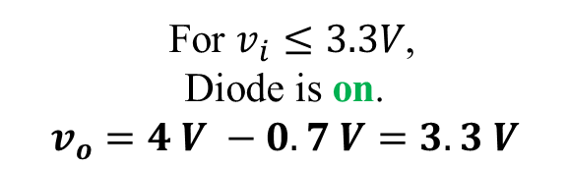

For $v_{i}>3.3V$,
Diode is off.
$$v_{o}=v_{i}$$
For $v_{i}≤3.3V$,
Diode is on.
$$v_{o}=4 V −0.7 V=3.3 V$$

Slide 11
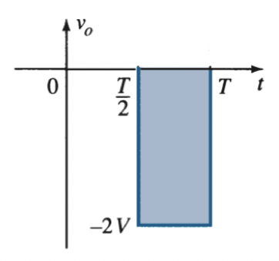
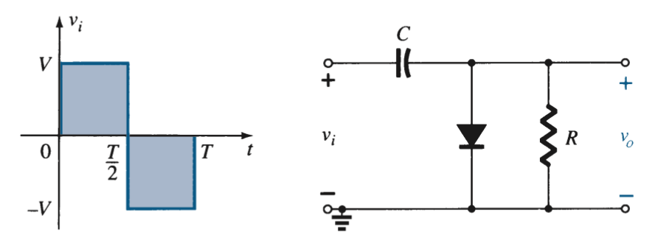
CLAMPERS
A clamper is a network constructed of a diode, a resistor, and a capacitor that shifts a waveform to a different dc level without changing the appearance of the applied signal.

Slide 12
CLAMPERS
Step 1: Start the analysis by examining the response of the portion of the input signal that will forward bias the diode.
Step 2: During the period that the diode is in the “on” state, assume that the capacitor will charge up instantaneously to a voltage level determined by the surrounding network.
Step 3: Assume that during the period when the diode is in the “off” state the capacitor holds on to its established voltage level.
Step 4: Throughout the analysis, maintain a continual awareness of the location and defined polarity for v_{o} to ensure that the proper levels are obtained.
Step 5: Check that the peak to peak voltage of the output matches that of the input.

Slide 13
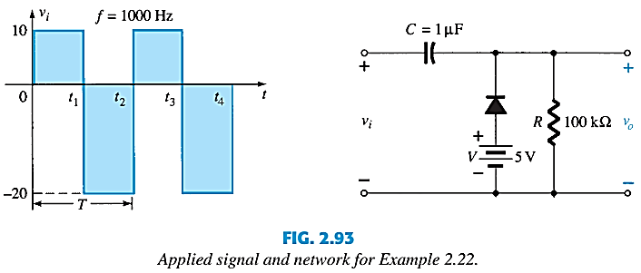
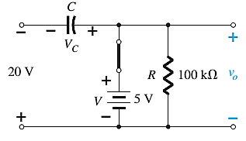
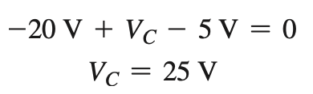

CLAMPERS
From t₁ to t₂ period of the input signal the diode will be forward biased.
$$v_{o}=5 V$$

Slide 14
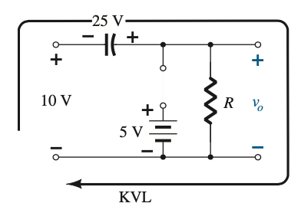
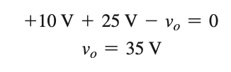
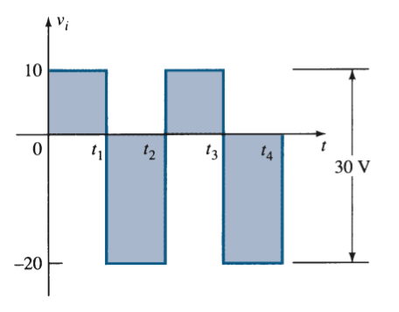
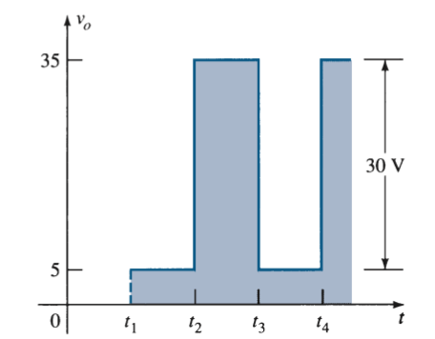
From t₂ to t₃ period of the input signal the diode will be reverse biased
The peak to peak value of output (30 V) matches with the input.
See Example 2.23

Slide 15
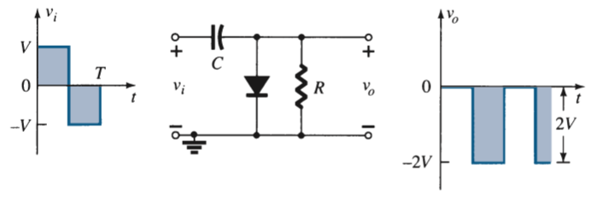
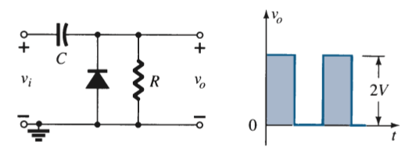
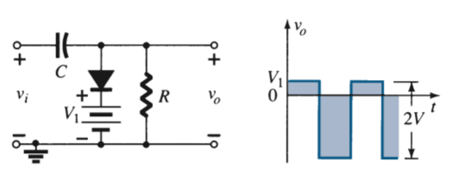
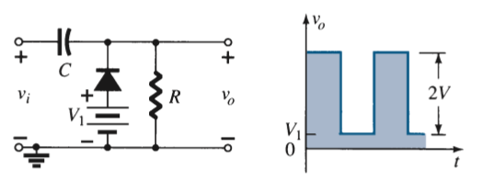
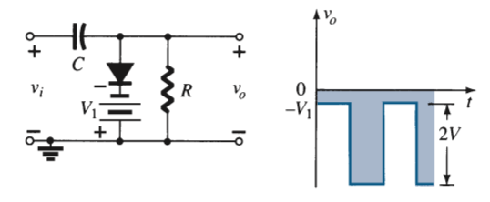
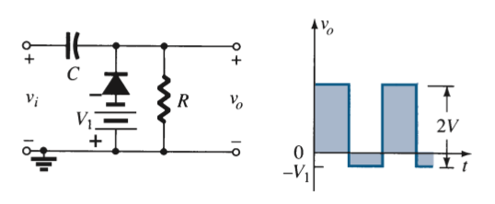
Clamping Networks

Slide 16
Thank You

